Slide 1
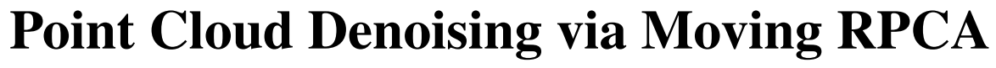
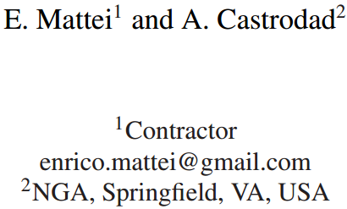
Computer Graphics Forum (CGF),2016.
Reporter：Ge Linlin
Date：2019.03.19

Slide 2
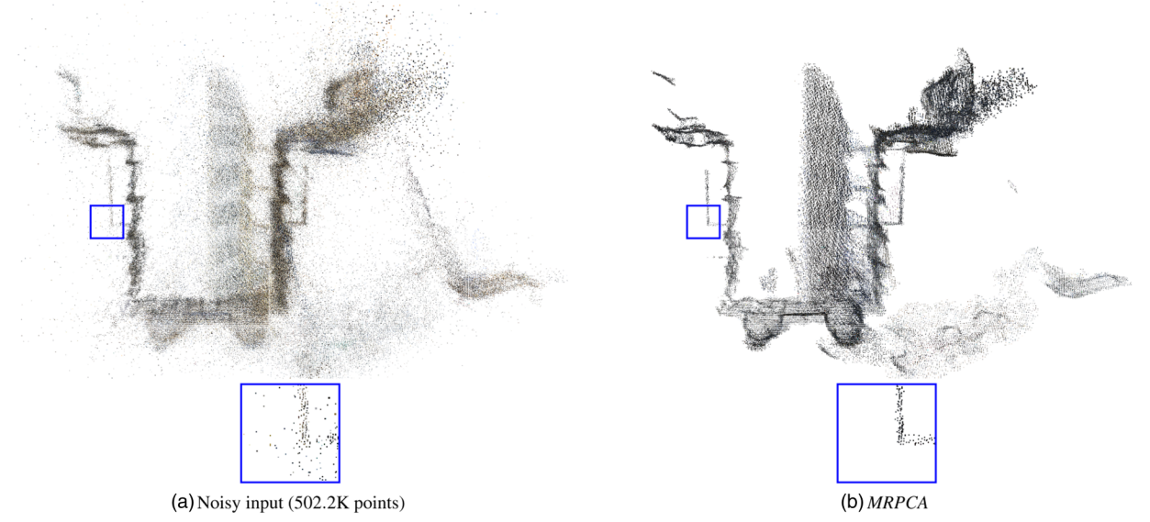
1. Introduction
Issues: Points’ Normal Estimation, Outlier Removal, Sharp Feature Preservation.
Algorithm: MRPCA with the full name Moving Robust Principal Component Analysis

Slide 3
1. Introduction
Contributions:
A model which dose not require oriented normals is proposed, it has the following properties:
It’s robust vis-à-vis outliers;
It does not require oriented normal as part of input;
Advantages:
Robust, Easy to implement and parallelize.

Slide 4
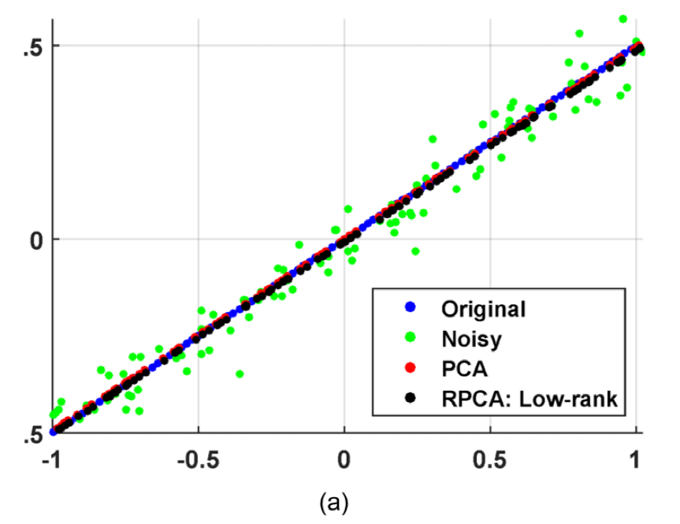
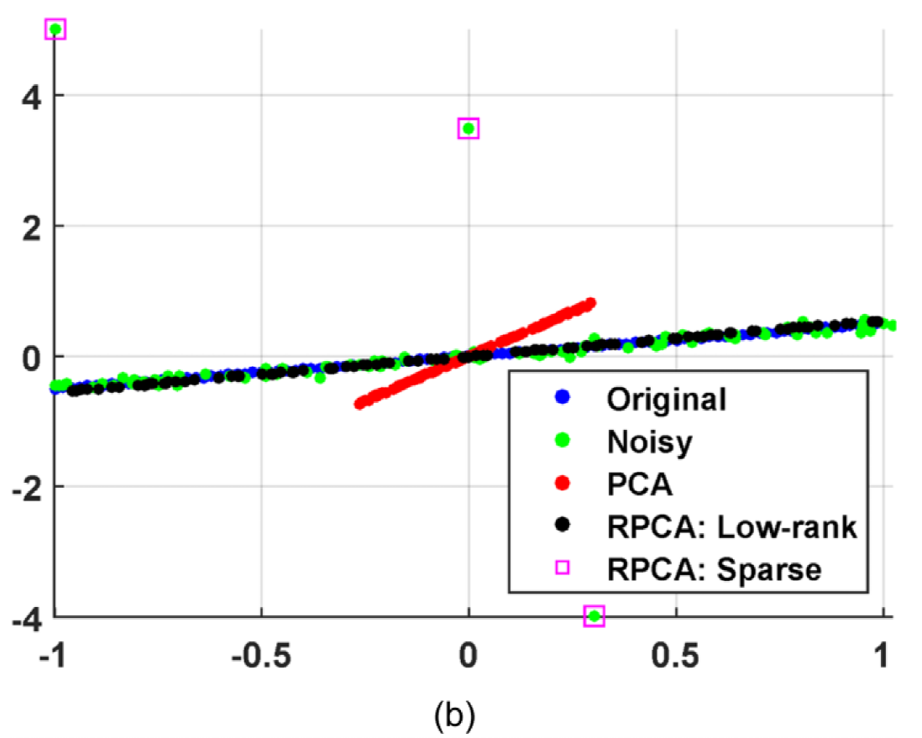
2. RPCA ( Robust Principal Component Analysis)
Why this paper is based on RPCA rather than PCA?
Compared to PCA, RPCA is more robust when facing outlier.
Without Outlier
With Three Outlier

Slide 5
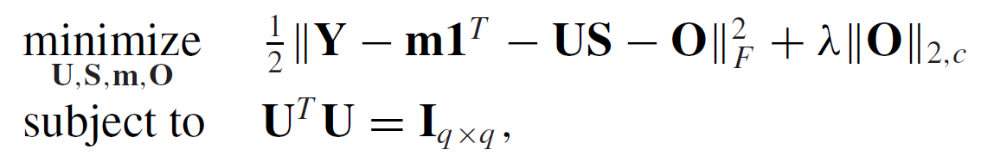
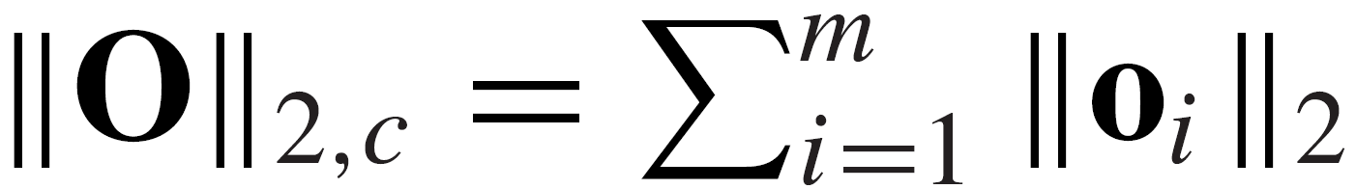
2. RPCA
Assumption:
Suppose that it is a linear problem.
Outlier-aware Factor Analysis Model:
Objective Function:
Applications:
Identification of invalid survey protocols
Video Surveillance
$$x_{i}=y_{i}+o_{i}=m+Us_{i}+e_{i}+o_{i} i=1,⋯,N$$
Where,

Slide 6
3 MRPCA (Moving Robust Principal Component Analysis)
MRPCA is an algorithm which applied RPCA to point cloud denoising.
(1) A factor analysis model to process local neighborhoods;
(2) A global approach to process overlapped regions.

Slide 7
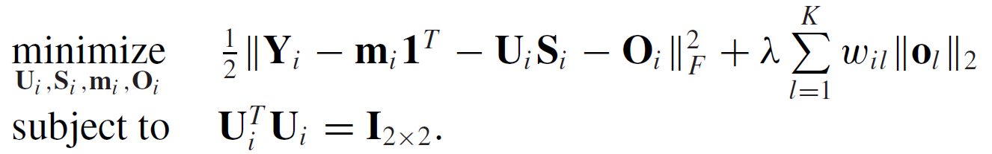
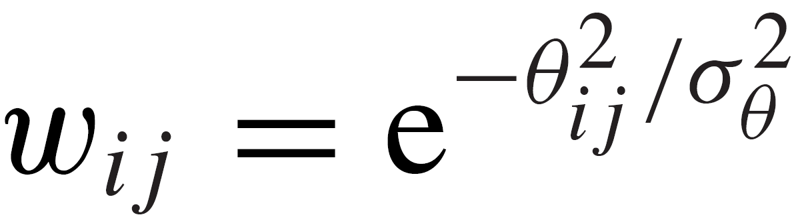
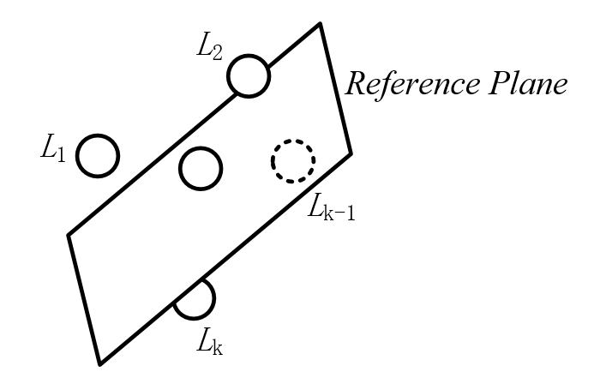
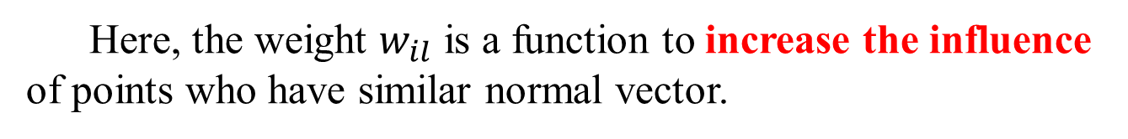
3.1 MRPCA —— Local Neighborhoods Processing
Here, the weight $w_{il}$ is a function to increase the influence of points who have similar normal vector.
Gaussian Kernel Function
or
Radial Basis Function
Angle between
Two Points’ Normals

Slide 8
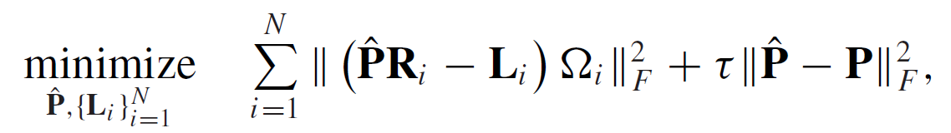
3.2 MRPCA —— Overlapped Regions Processing

Slide 9
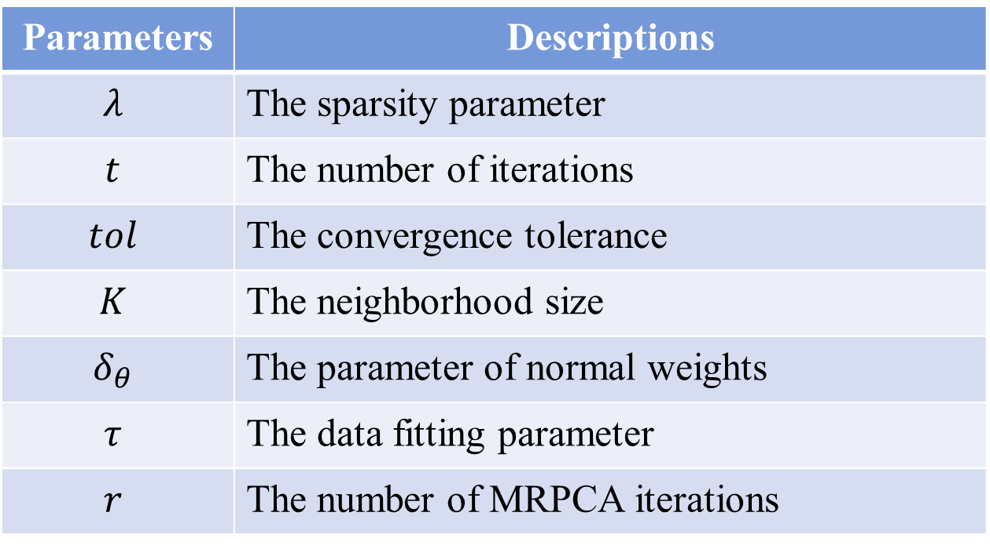
3.3 MRPCA —— Parameter Selection and Tuning
Parameters | Descriptions
$$λ$$ | The sparsity parameter
$$t$$ | The number of iterations
$$tol$$ | The convergence tolerance
$$K$$ | The neighborhood size
$$δ_{θ}$$ | The parameter of normal weights
$$τ$$ | The data fitting parameter
$$r$$ | The number of MRPCA iterations

Slide 10
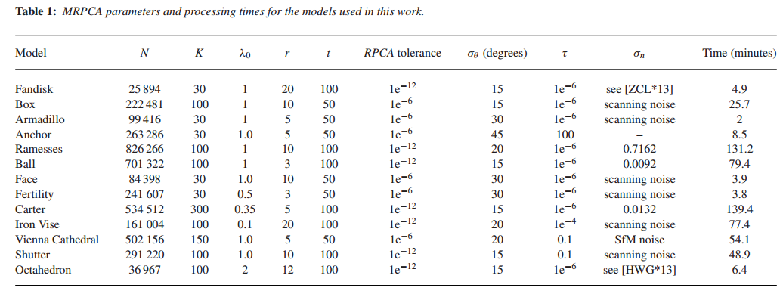
3.3 MRPCA —— Parameter Selection and Tuning

Slide 11
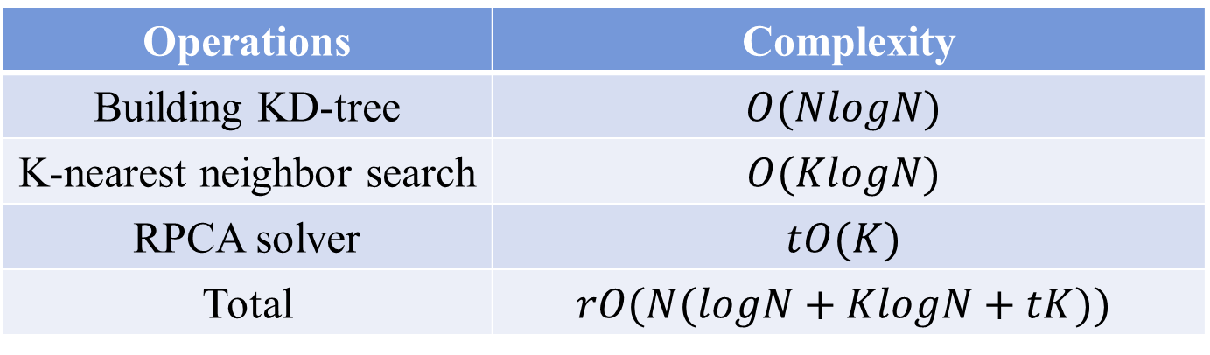
3.4 MRPCA —— Computational Complexity
Operations | Complexity
Building KD-tree | $$O(NlogN)$$
K-nearest neighbor search | $$O(KlogN)$$
RPCA solver | $$tO(K)$$
Total | $$rO(N(logN+KlogN+tK))$$
The maximum iteration times of MRPCA
The size of neighbourhoods
The maximum iteration times of RPCA solver

Slide 12
4. Results
Algorithms | Libraries
WLOP | CGAL
Bilateral filter | CGAL
AWLOP+EAR re-sampling method | http://vcc.szu.edu.cn/research/2013/EAR
Point reconstruction | CVX

Slide 13
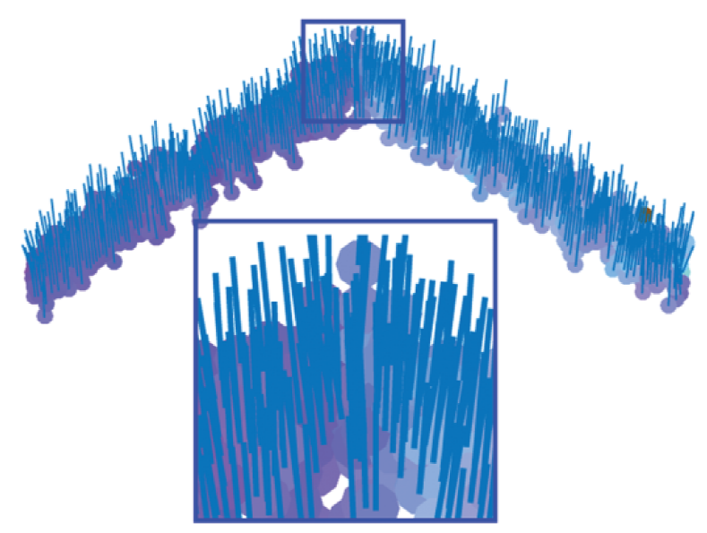
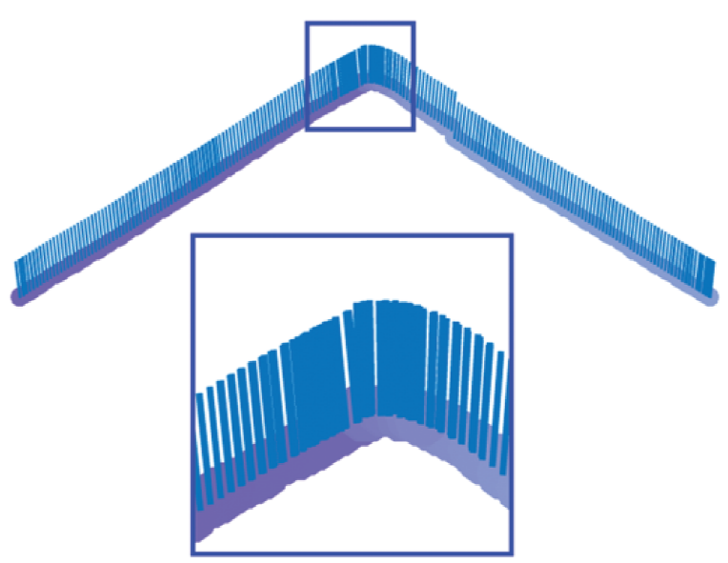
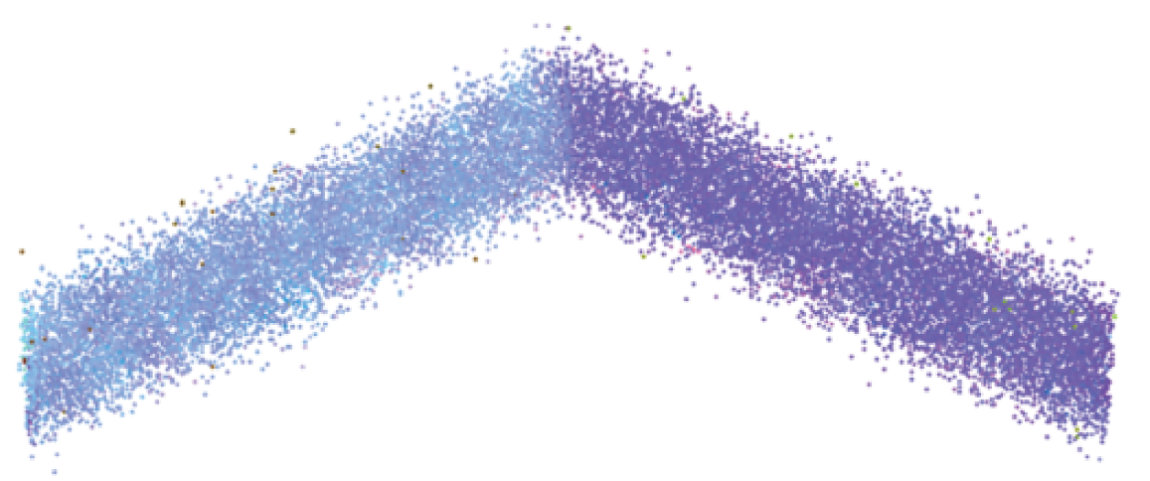
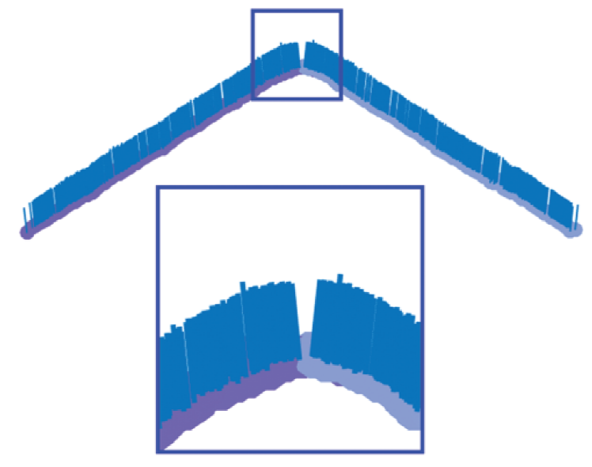
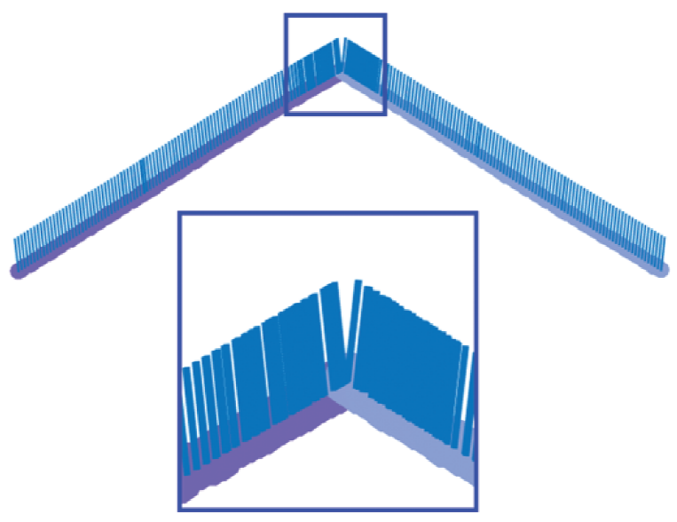
4. Results—— Sharpe Feature Test
Noisy input PCA Bilateral Filter
AWLOP MRPCA

Slide 14
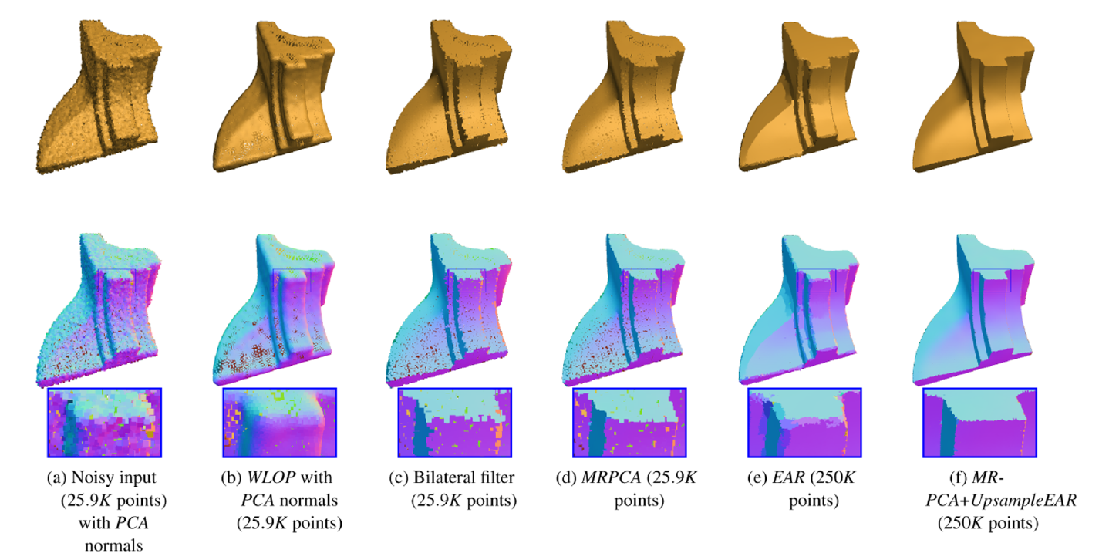
4. Results —— Handling Sharp Features

Slide 15
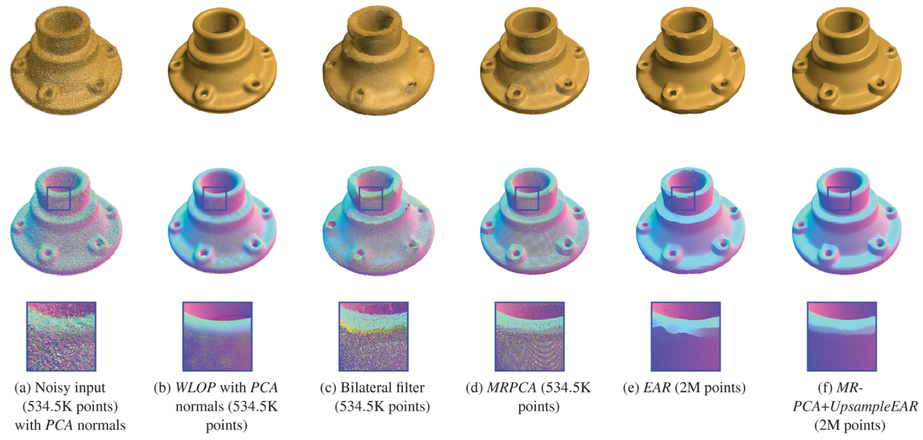
4. Results —— Handling SFM Model

Slide 16
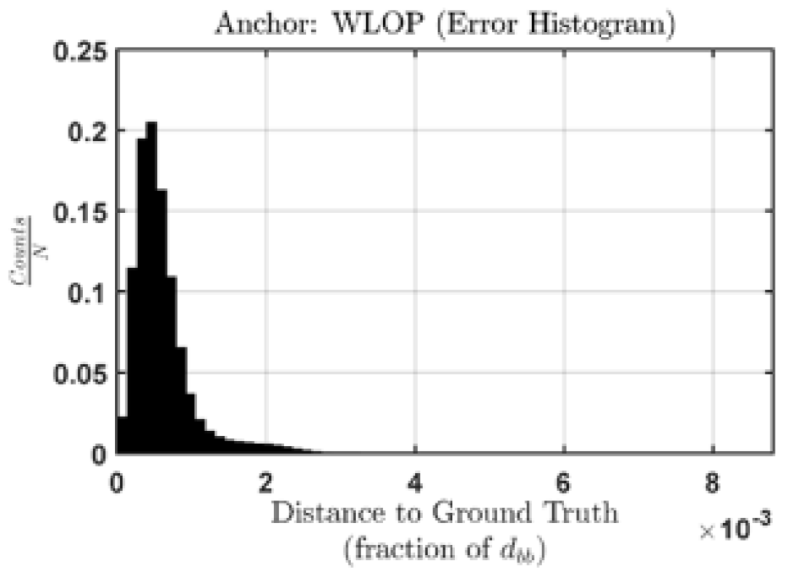
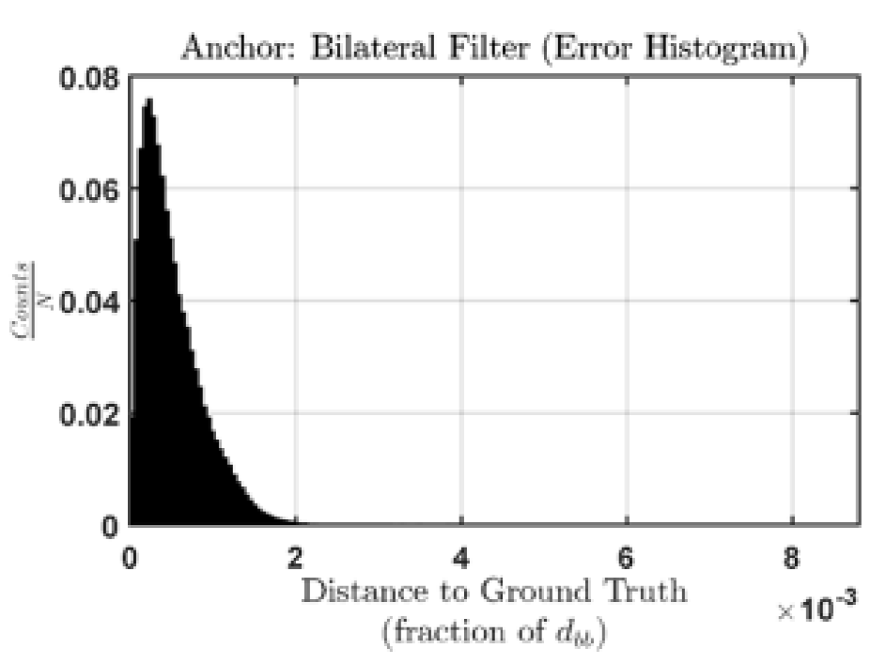
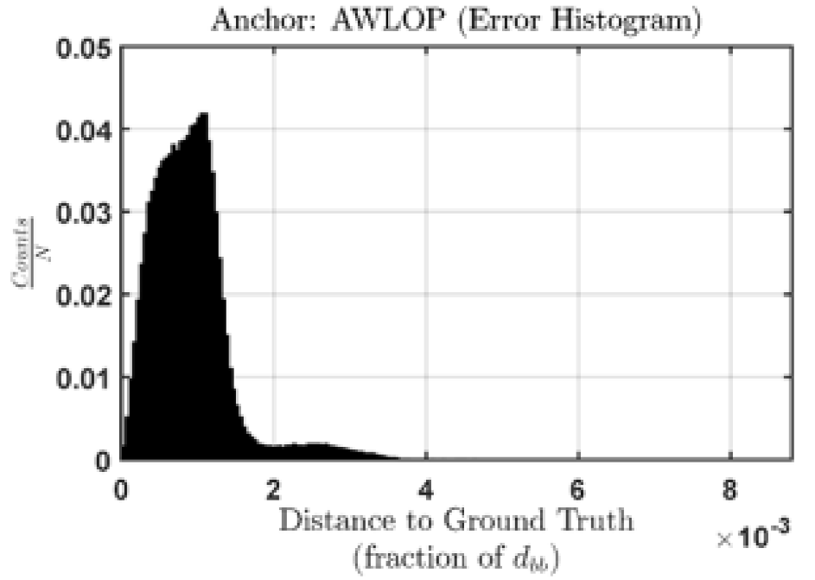
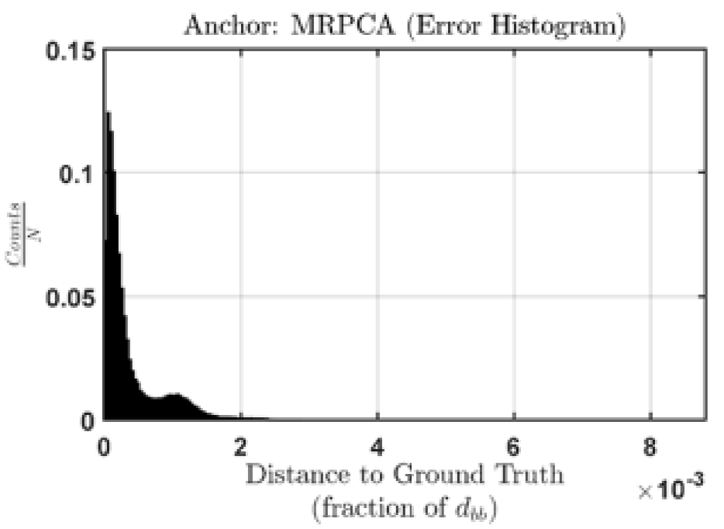
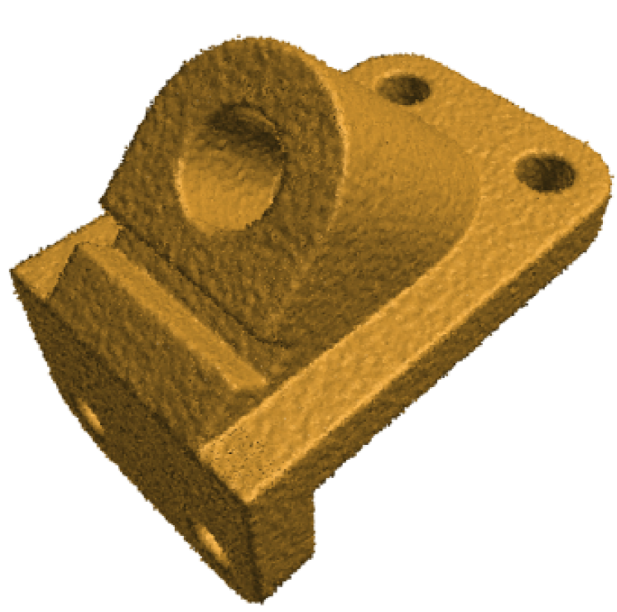
4. Results ——Error Analysis

Slide 17
5. Limitations
When facing sharp features and high noise levels, computation of MRPCA will considerably increase due to a larger neighbourhood.
Normals estimated by RPCA are not stable.

Slide 18
5. Conclusion
MRPCA is effective in denoising point cloud with and without sharp feature;
MRPCA is outperform well-known approaches such as the bilateral filter, WLOP and AWLOP;
L1-norm worked better than Frobenius norm, but Frobenius norm is used in this article to decrease computation;
The neighbourhood size is obtained from a function which is relevant to local point density.

Slide 19
Thanks!

